Slide 1

Visualization and Quantitative analysis of School Quality in New York City
Urban Accessibility
Karandeep Singh
Shivam Bhirud
Falgoun Paatil
Andrea Garcia Tapia
Dr. Jose Emmanuel Ramirez-Marquez

Slide 2
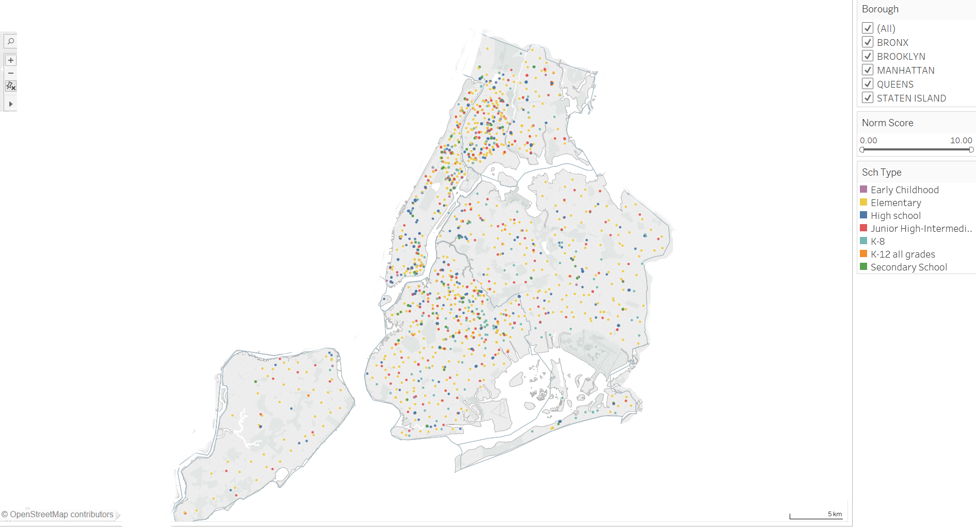
Dot plot of schools in NYC
Borough | School Count
Brooklyn | 518
Bronx | 400
Manhattan | 325
Queens | 315
Staten Island | 72
Colour shows details about School Type.
The data is filtered on Borough and the view is filtered on Norm Score, which ranges from 0.00 to 10.00

Slide 3
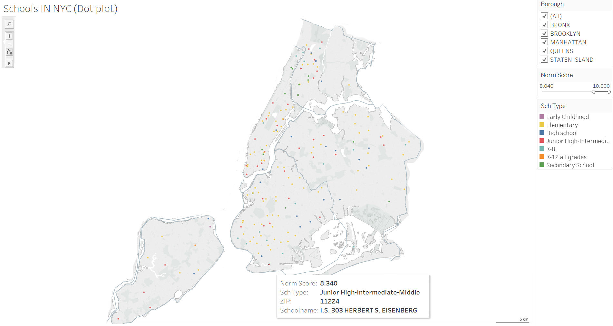
Top rated schools in NYC – Dot plot
Borough | School Count
Brooklyn | 61
Bronx | 28
Manhattan | 44
Queens | 38
Staten Island | 12
The view is filtered on Norm Score, which ranges from 8.040 to 10.000

Slide 4
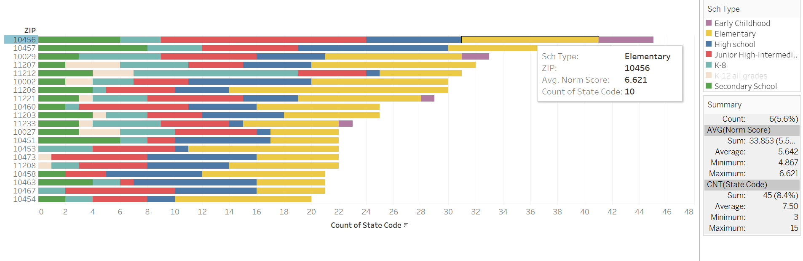
Ranking Zip Codes based of number of schools contained
Allows the government to identify the amount of schools (even aggregated by type of school) in a Zip Code
Table shows the Areas near the Zips ranked in the same order as the bar chart

Slide 5
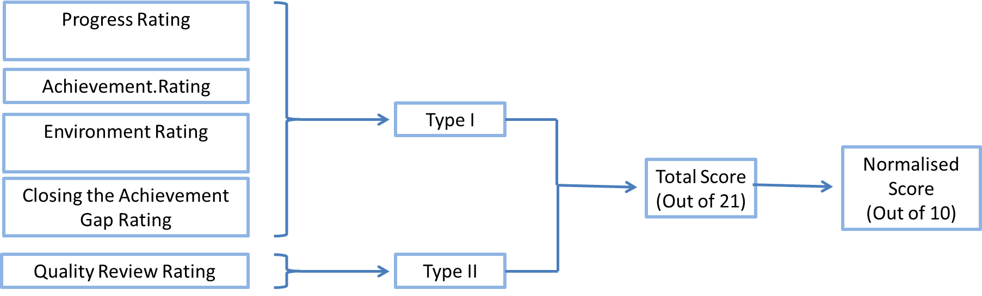
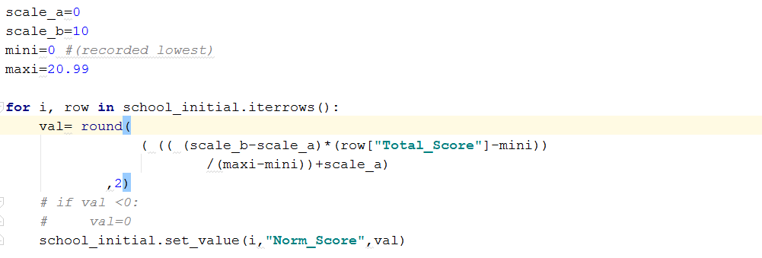
School Quality Evaluation Index
Normalization Formula : Norm. Score
Progress Rating
Achievement.Rating
Environment Rating
Type I
Total Score (Out of 21)
Normalised Score
(Out of 10)
Closing the Achievement Gap Rating
Quality Review Rating
Type II

Slide 6
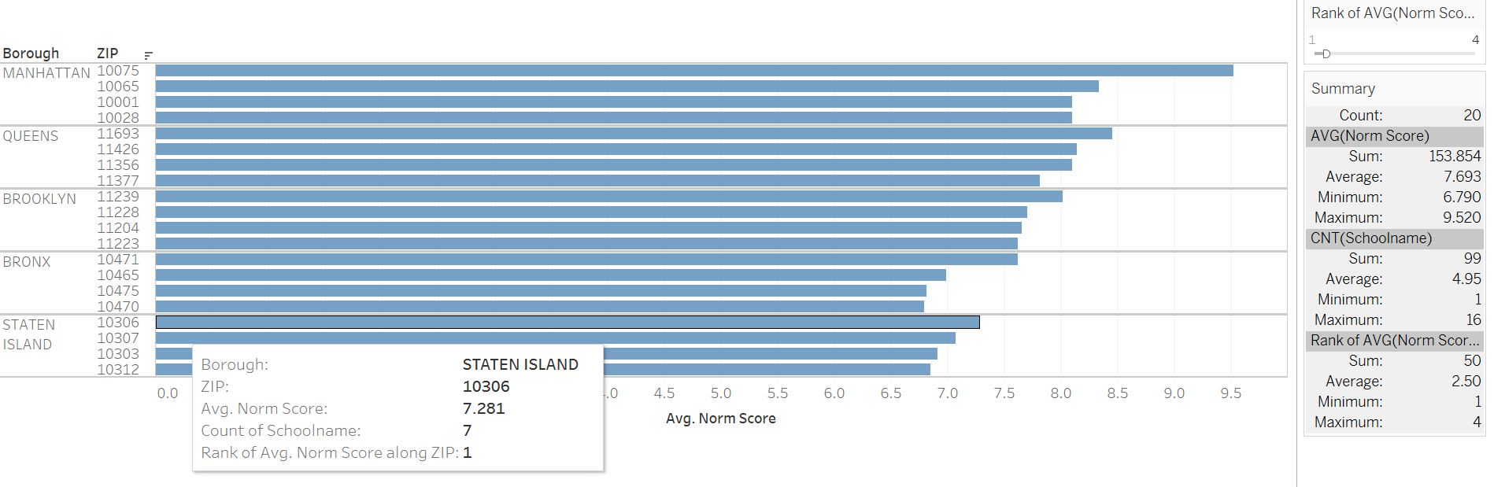
Norm. Score (Avg) aggregated by Zip Code
Rank-wise of Avg. Normalised Score broken down by Borough and ZIP.
Top 4 Rank of Avg. Norm Score displayed
Provides parents with Area ( Zip ) Codes with Top Quality schools
Boroughs within NYC can be compared amongst each other based on Normalised Score

Slide 7
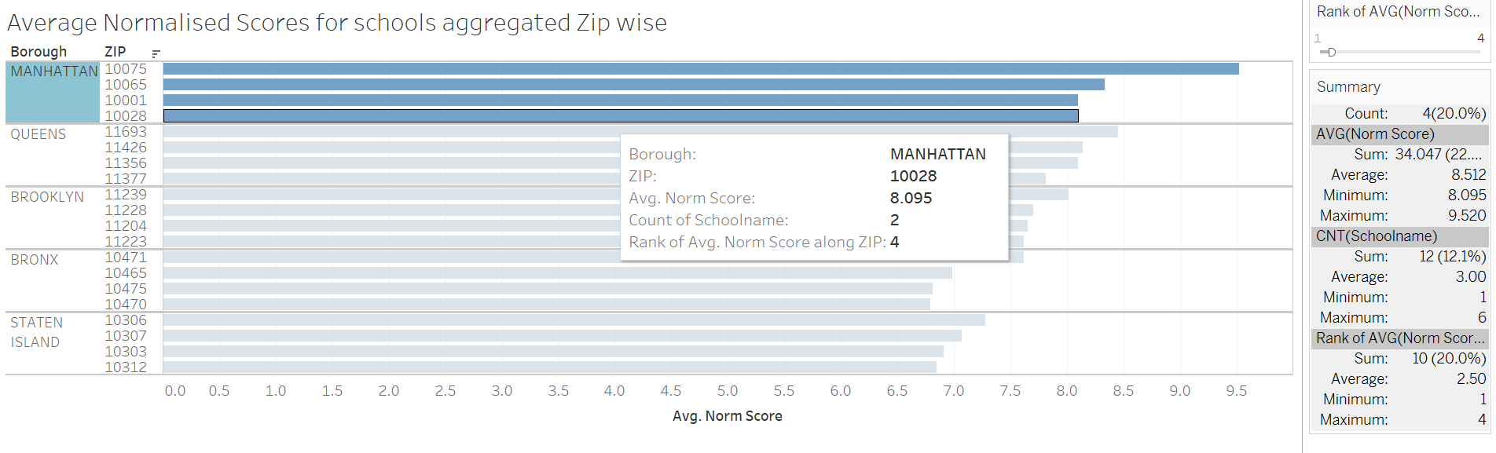
2 Level Drill down to Borough (Manhattan, the top rated for education )
Average normal Score allow ranking of zips in Borough.
Table provides the top schools contribution to the Rank and their respective Norm. Scores

Slide 8
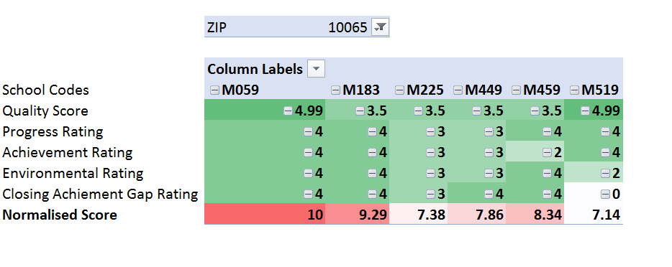
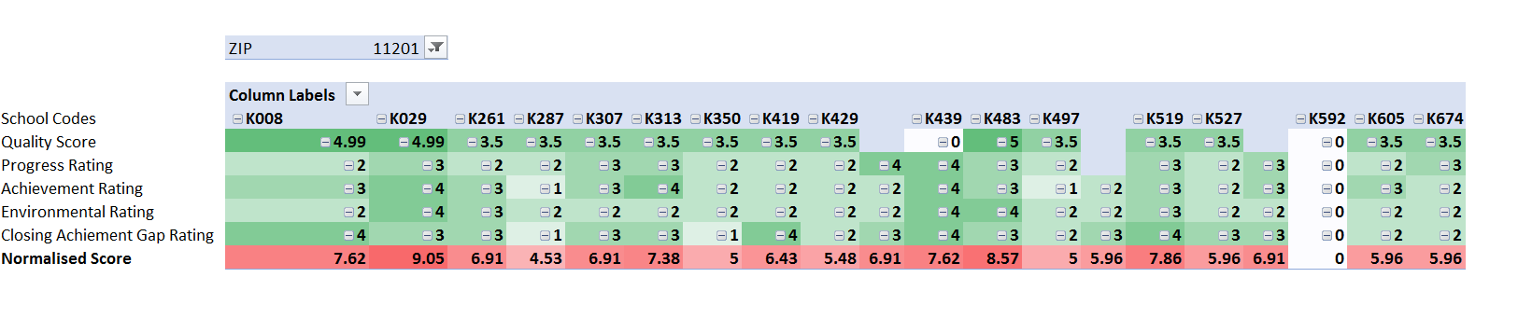
Heat Map for School Quality in particular Zip : An Interactive Visual
Heat Map for Zip : 11201
Name: COBBLE HILL SCHOOL OF AMERICAN STUDIES
Code: K519
Normalised Score: 7.86
Rank (by Zip): 3

Slide 9
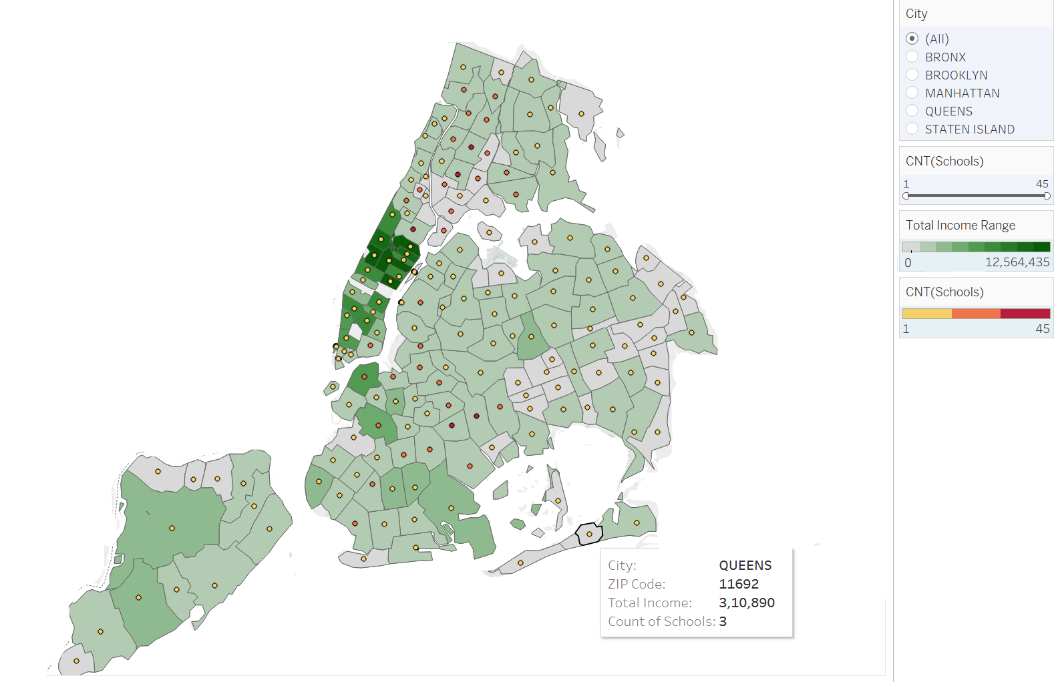
Average Household Income VS School Distribution
Dot colour shows count of Schools.
Data layer colour (Heat) shows Average Total Income as an attribute.
The data is filtered on count of schools in a Zip.
The view is filtered on count of Schools and City. The count of Schools filter ranges from 1 to 45.

Slide 10
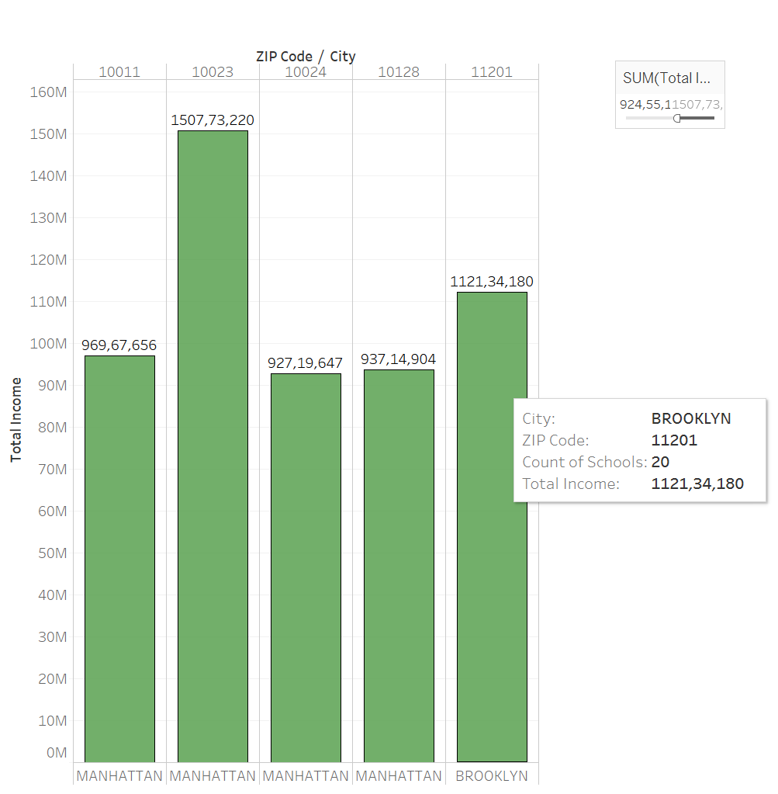
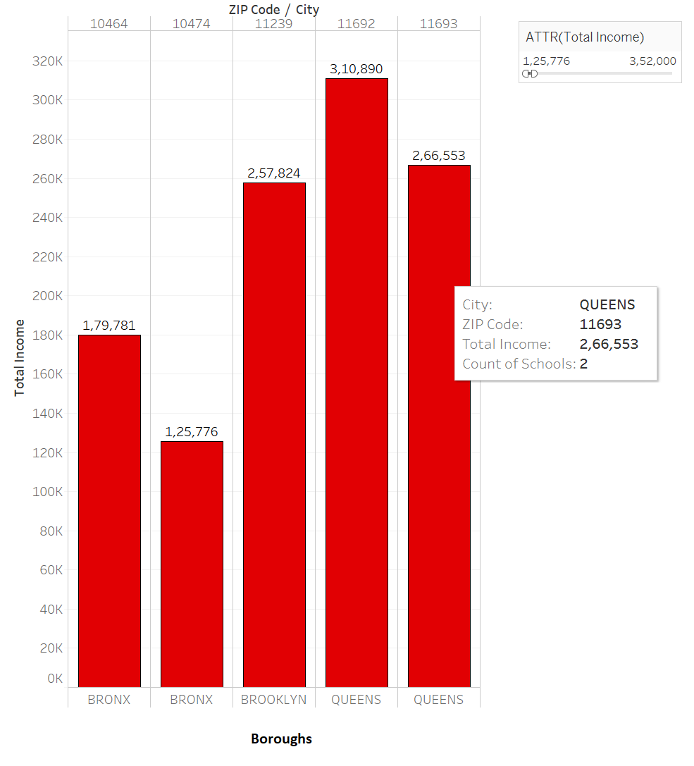
Concluding Arguments
1. Most Vulnerable and Most Accessible Areas Based on Average Household Income with regards to schools
Boroughs
Maximum Household Income Distribution
Minimum Household Income Distribution

Slide 11
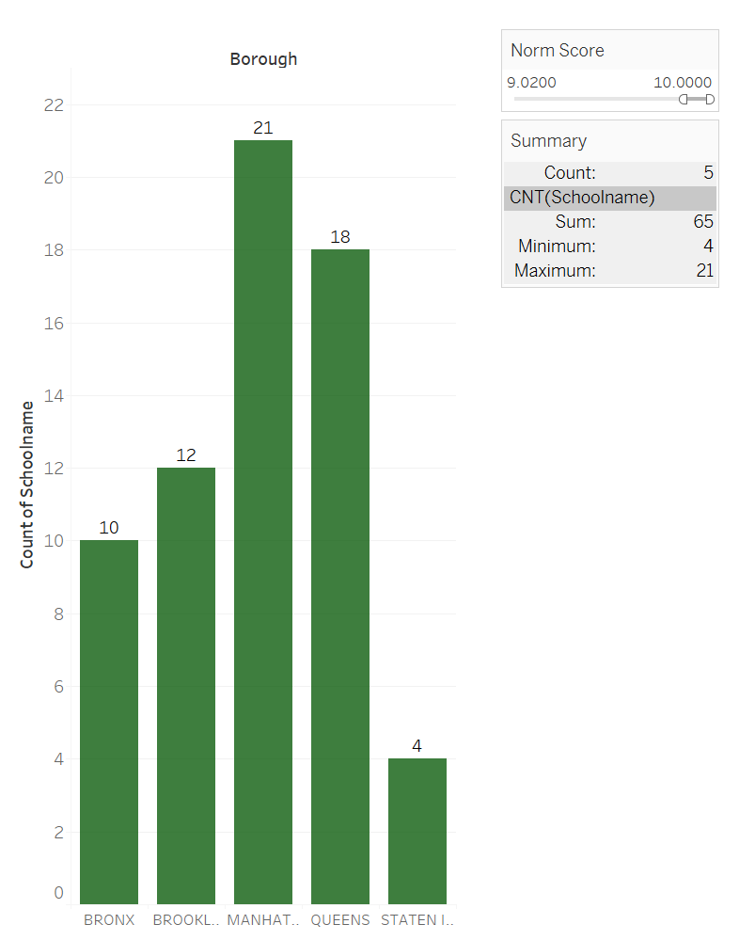
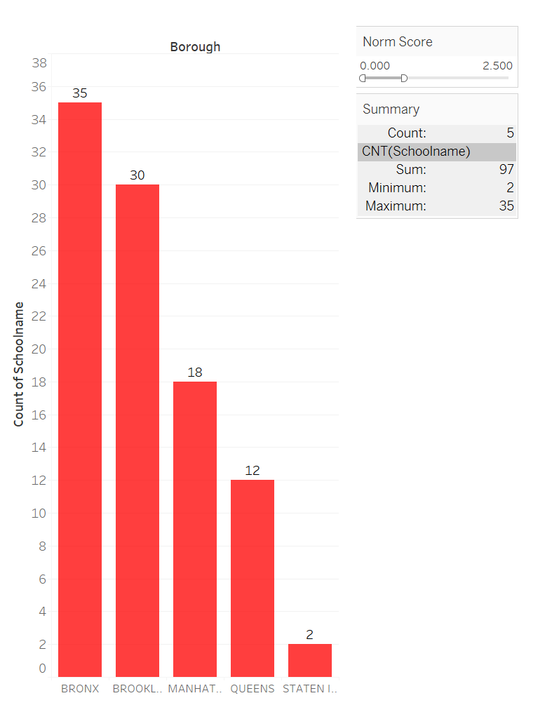
2. Most Vulnerable and Most Accessible Areas Based on Quality of education in schools
Count of Schools having Highest Quality Education
( Norm. Score between 9-10)
Count of Schools having Lowest Quality Education
( Norm. Score between 0-2)

